Slide 1
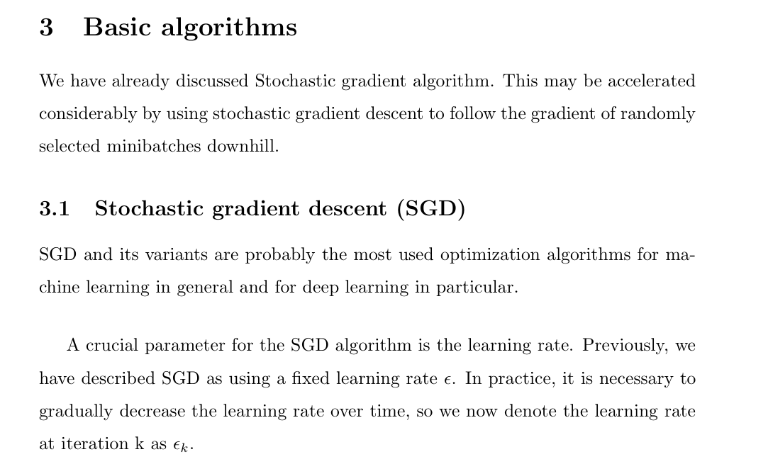

Slide 2
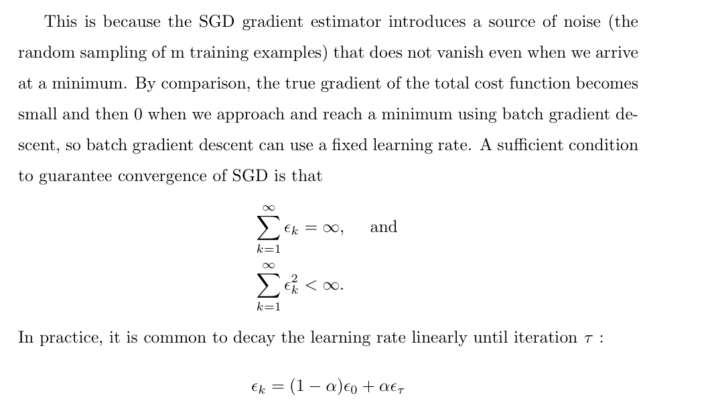

Slide 3
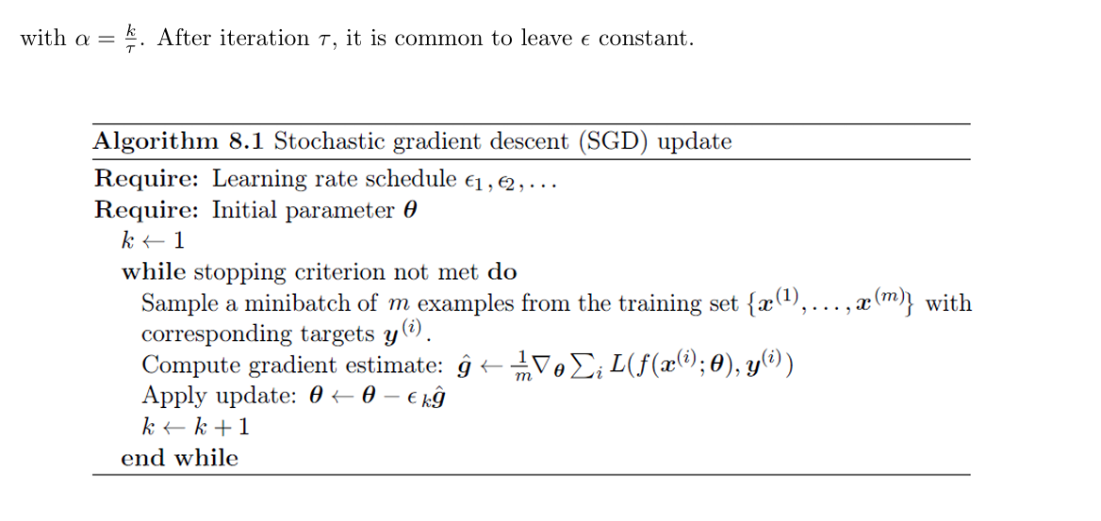

Slide 4
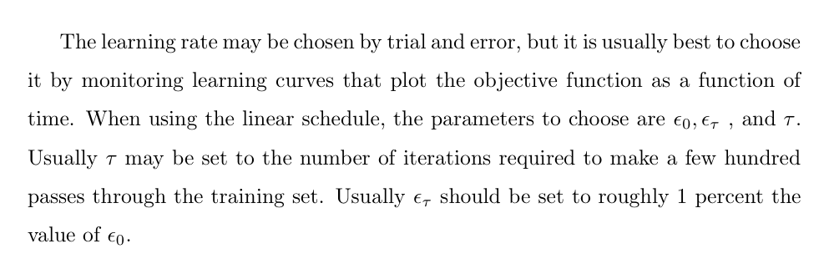

Slide 5
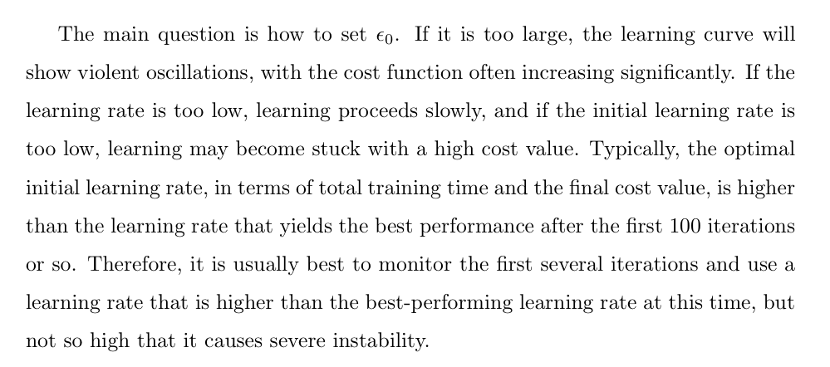

Slide 6
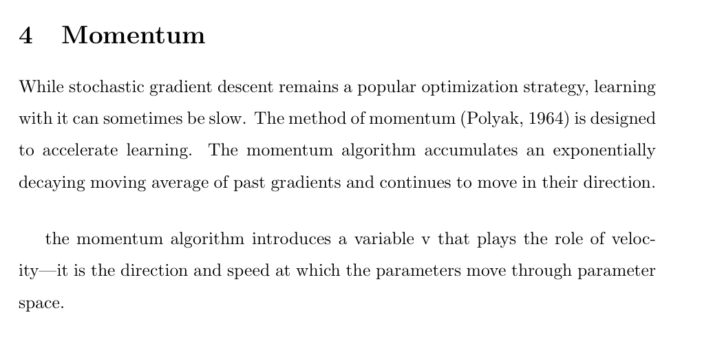

Slide 7
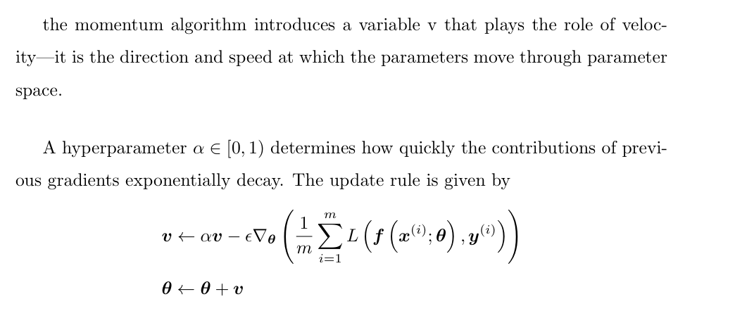

Slide 8
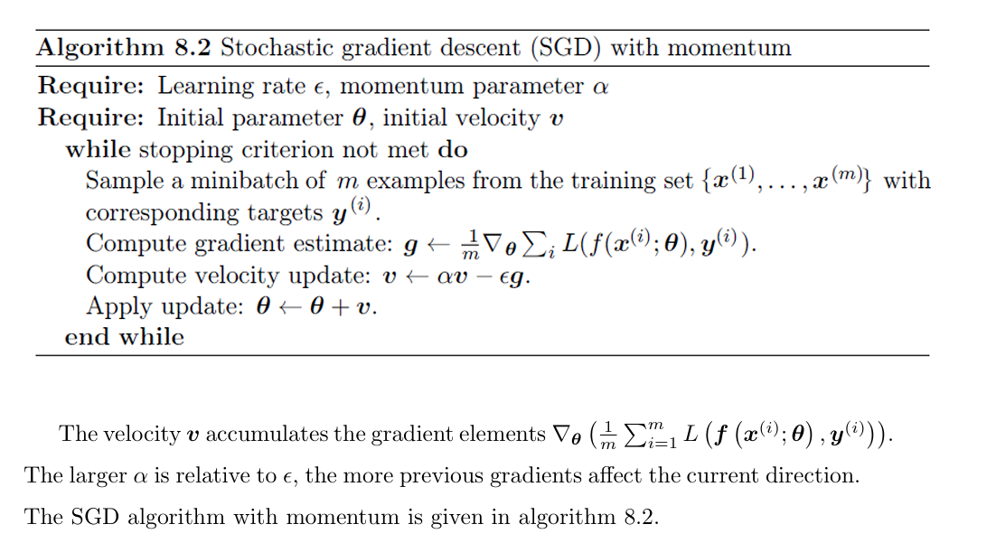
Advantages ?

Slide 9
Advantages ?, faster convergence, smoothens oscillations, large learning rate

Slide 10
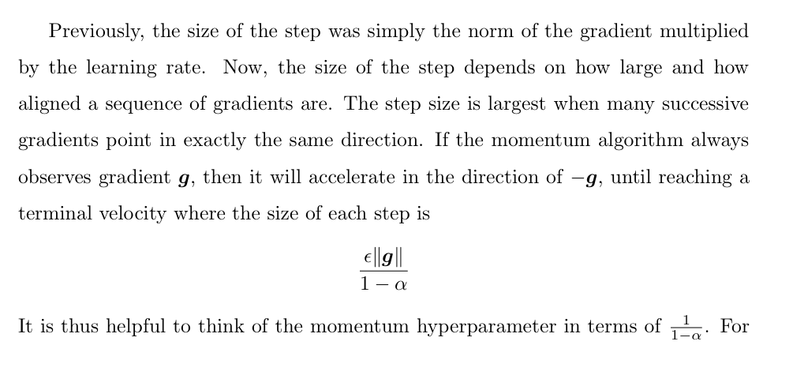
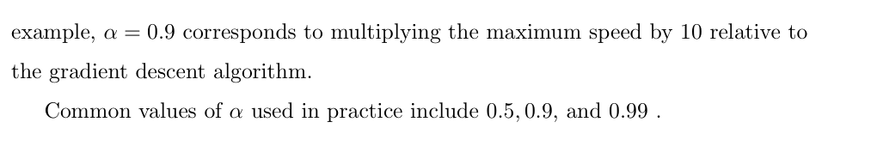

Slide 11
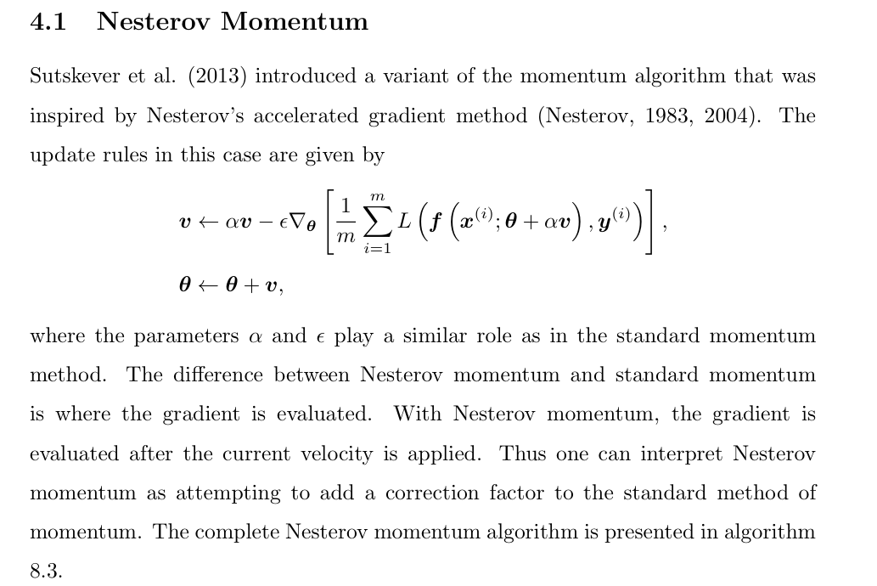

Slide 12
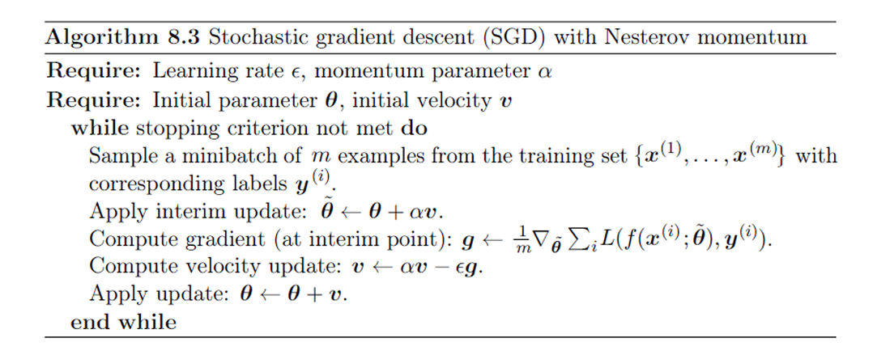

Slide 13
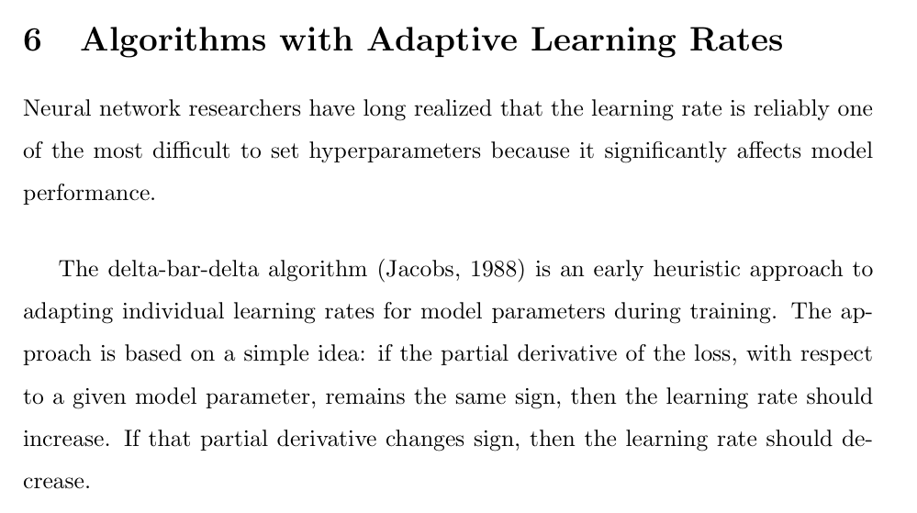
Assessment 1 and 2 uploaded for lab and lab quiz on Thursday

Slide 14
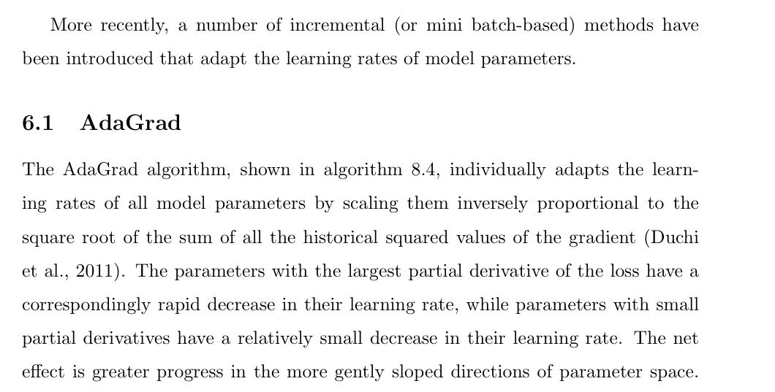

Slide 15
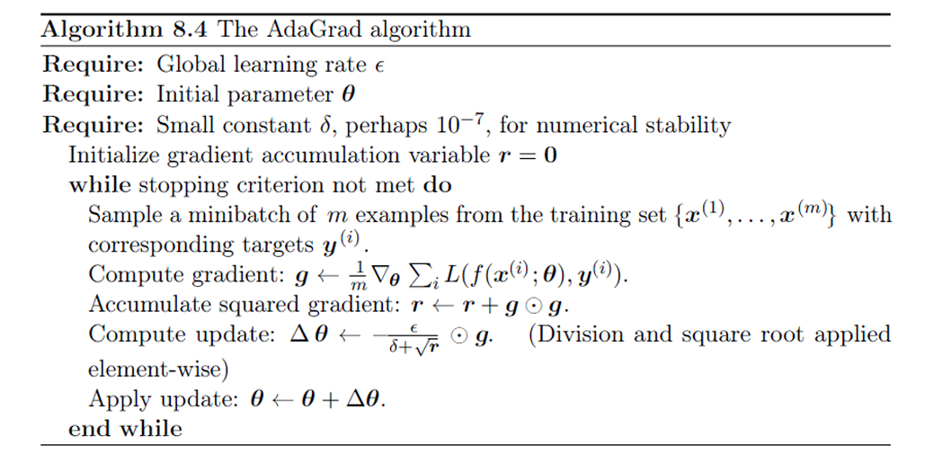

Slide 16
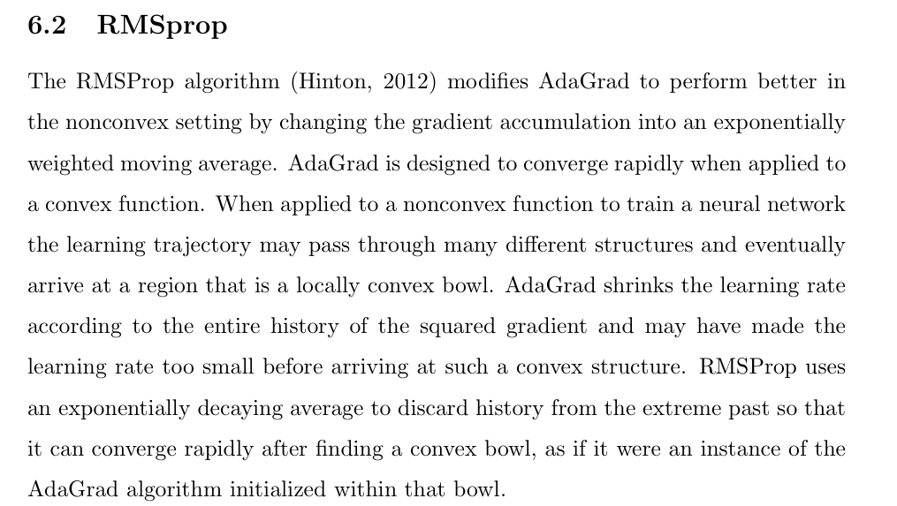

Slide 17
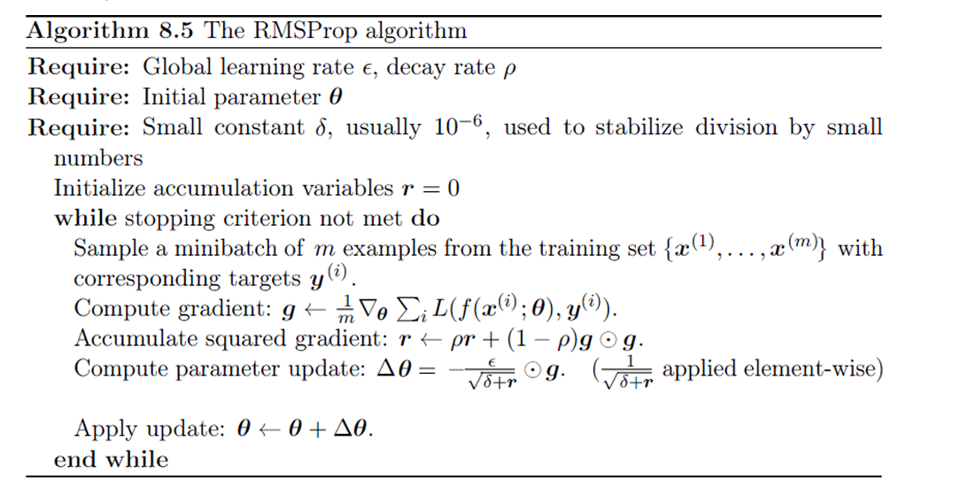
An exponentially decaying average of squared gradients is computed. Prevents from the denominator growly rapidly. r = E(g²)

Slide 18
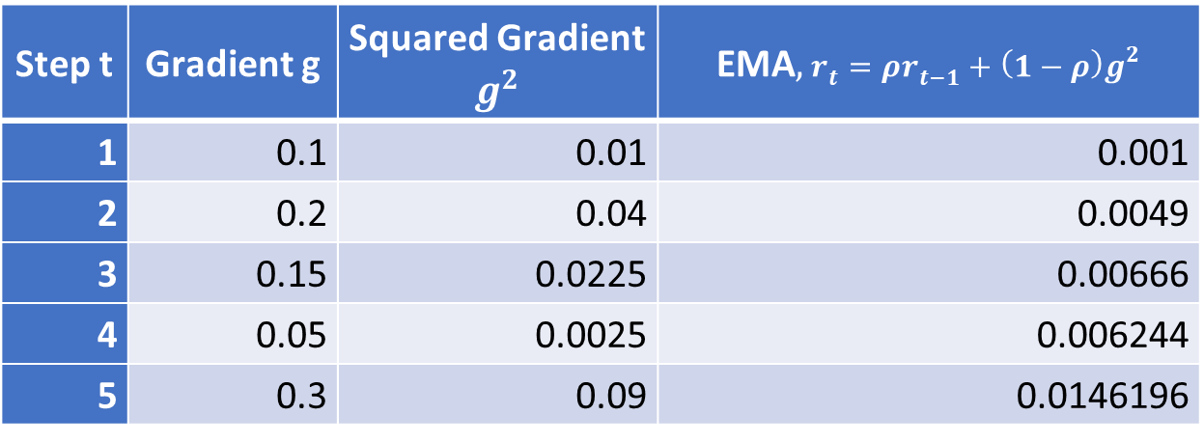
Step t | Gradient g | Squared Gradient $g^{2​}$ | EMA$,r_{t}=ρr_{t−1}+\left(1−ρ\right)g^{2}$
1 | 0.1 | 0.01 | 0.001
2 | 0.2 | 0.04 | 0.0049
3 | 0.15 | 0.0225 | 0.00666
4 | 0.05 | 0.0025 | 0.006244
5 | 0.3 | 0.09 | 0.0146196
Rho = 0.9, Keeps learning rate adaptive, but prevents it from shrinking to near zero, unlike Adagrad

Slide 19
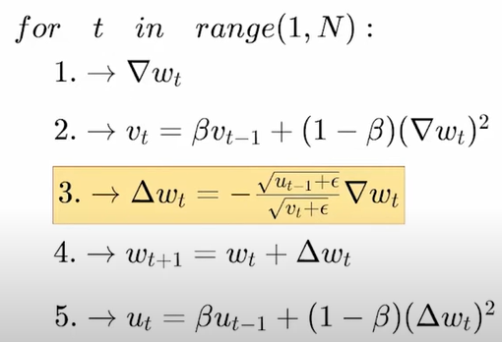
Adadelta (2012)
RMSProp still needs a manual global learning rate η.
And some parameters might still update too aggressively or too slowly.

Slide 20
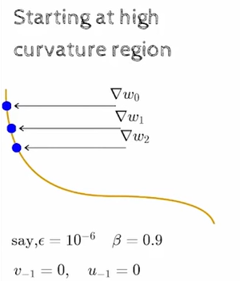
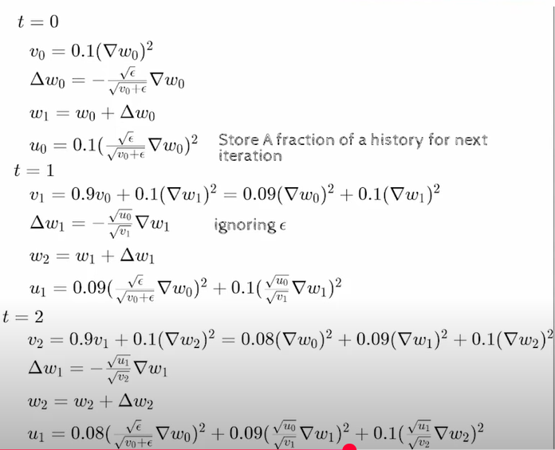

Slide 21
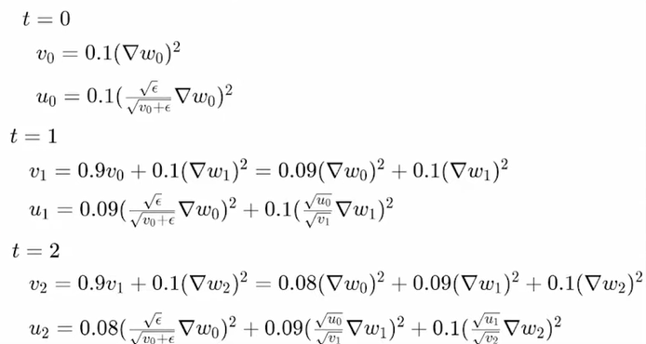
We will have a low learning rate because the numerator will be smaller than the denominator.

Slide 22
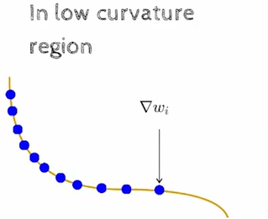
The u_{t-1} value now starts becoming bigger and thus the learning rate increases in flat regions.

Slide 23
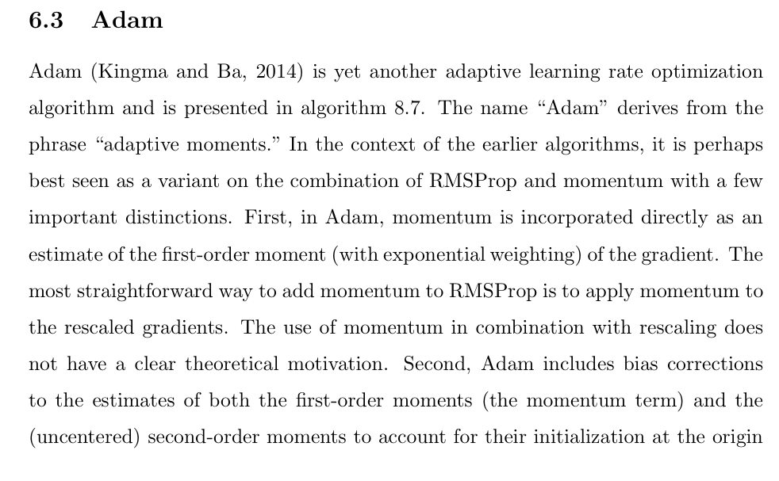

Slide 24
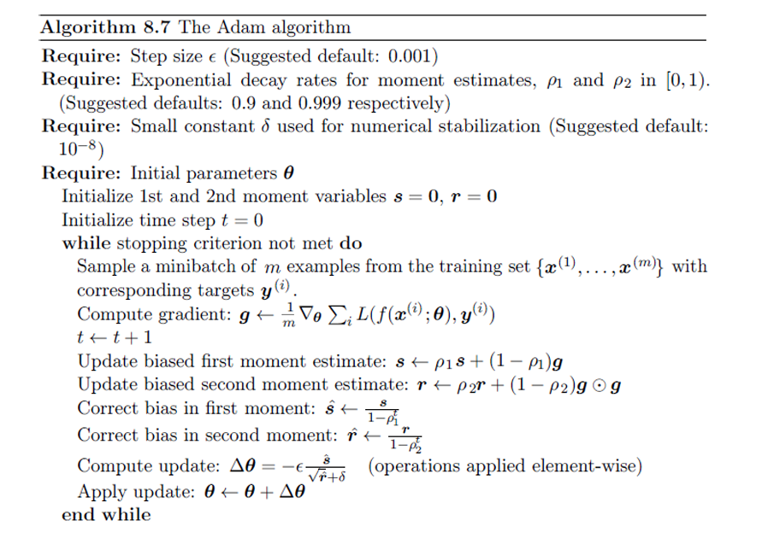

Slide 25

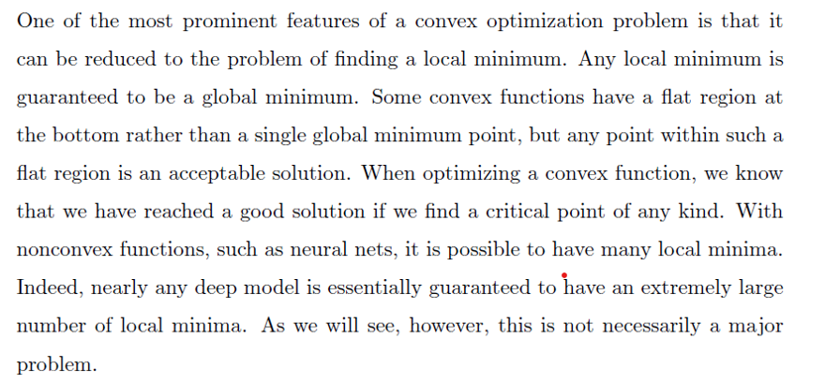

Slide 26
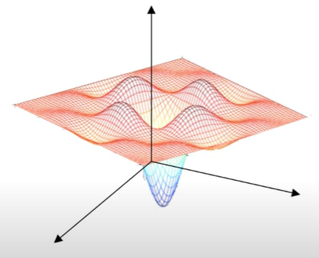
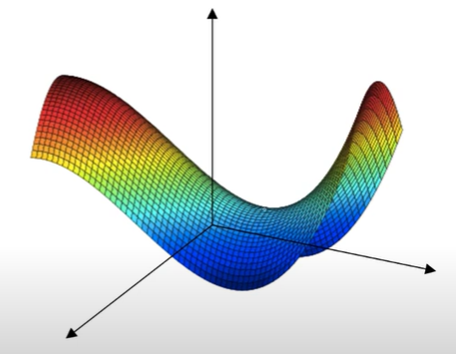
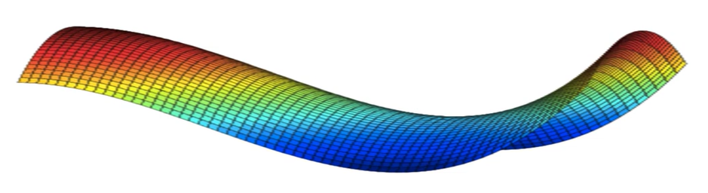
Local minima
Saddle points
Plateaus
A saddle point is a point where the gradient is zero, but it is not a minimum (nor maximum).
If eigenvalues of Hessian matrix are mixed (some positive, some negative), the point is a saddle point.

Slide 27
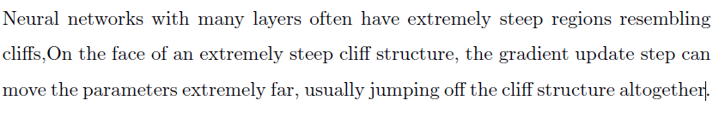
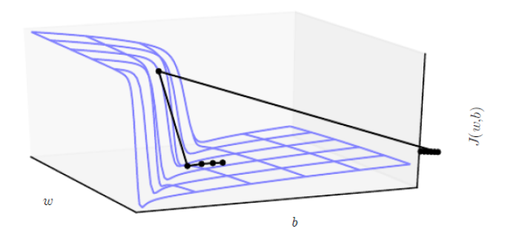
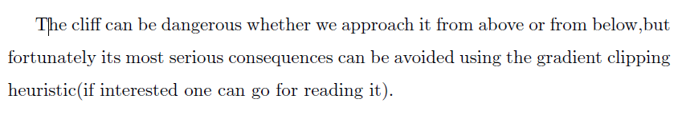
Cliffs

Slide 28
Ways to skip/escape saddle points, local minima, and plateaus
1. Stochasticity from mini-batch SGD
Small random fluctuations in gradients (due to sampling mini-batches) provide noise. This noise often helps the optimizer “kick out” of saddle regions instead of staying stuck. That’s why full-batch gradient descent is rarely used.
2. Momentum-based optimizers
Momentum, Nesterov momentum, Adam, RMSProp → keep some memory of past updates. This prevents the optimizer from stopping at a flat region. Intuitively: it keeps the “ball rolling” across saddle surfaces.
3. Learning rate schedules
Larger learning rates help cross shallow saddle points faster. Cyclical LR (Polynomial decay cycle option) can re-inject energy into the optimizer to escape plateaus and saddles. ReduceLROnPlateau is useful after escape, for fine-tuning.
4. Second-order methods (theory side)
In principle, the Hessian matrix can tell you if you’re at a saddle point (mixed eigenvalues).
5. Overparameterization
Large networks have many redundant directions in parameter space. (Stochastic gradient). This makes it easier to bypass saddles because there are many alternative descent paths.
6. Regularization tricks

Slide 29
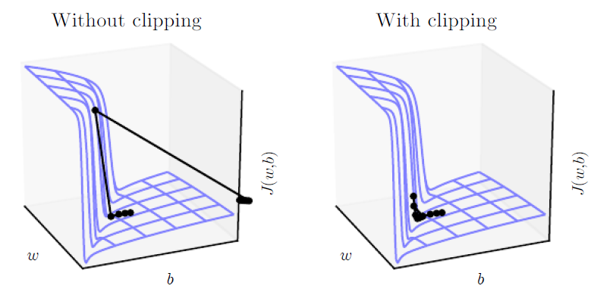

Slide 30
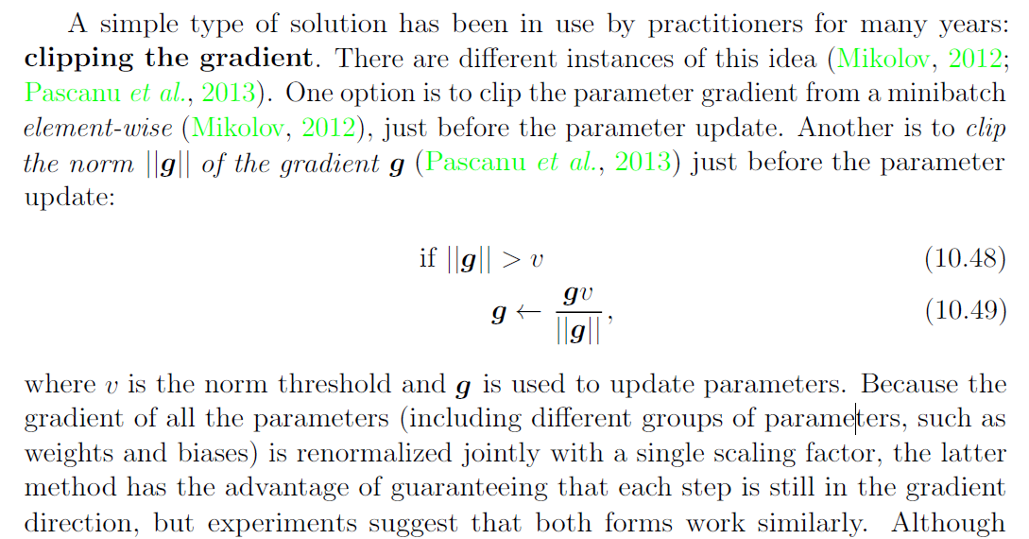

Slide 31
Vanishing or exploding gradient problem
Vanishing gradients make it difficult to know which direction the parameters should move to improve the cost function, while exploding gradients can make learning unstable. The cliff structures described earlier that motivate gradient clipping are an example of the exploding gradient phenomenon.

